Slide 1
HABs Quick Look – Flight on October 5, 2015
Bob Shuchman
Mike Sayers
Reid Sawtell
Glenn Sullivan

Slide 2
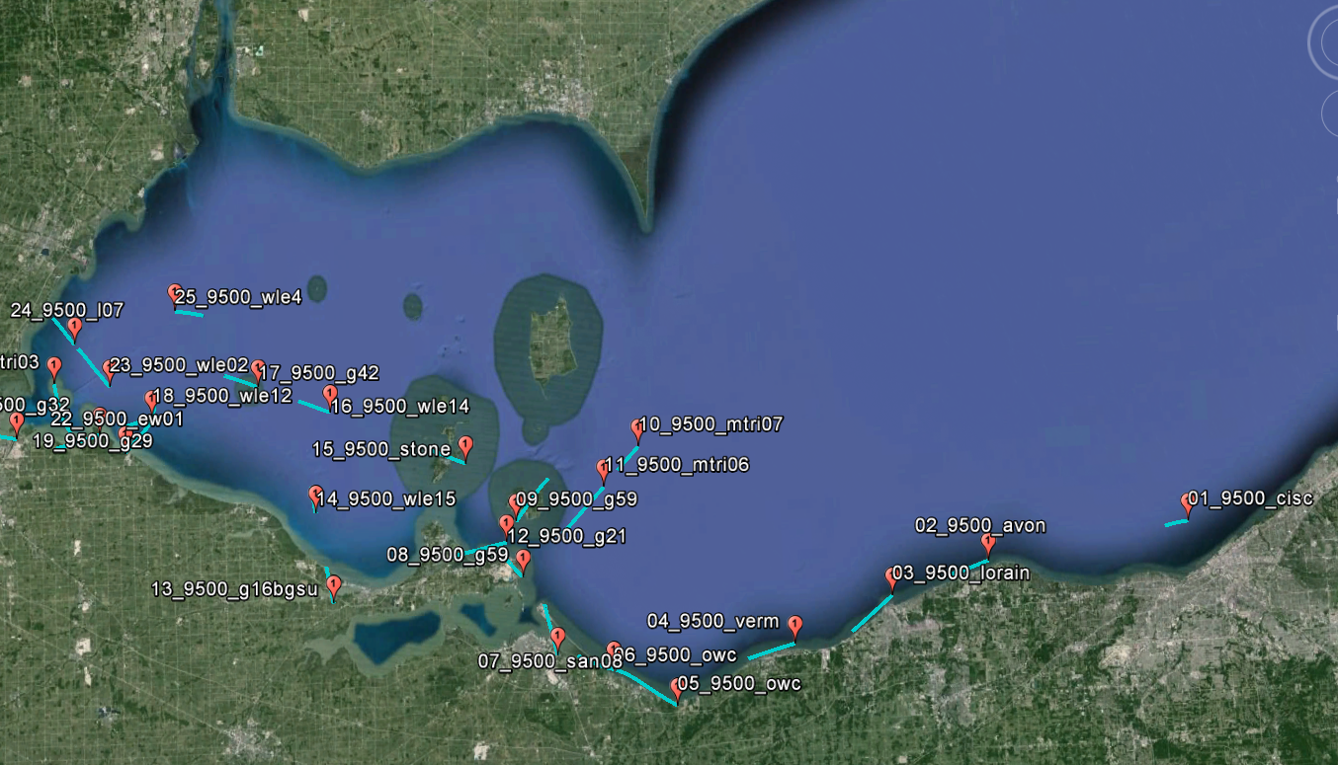
Aircraft Flight Lines – 10/05/15 Flight

Slide 3
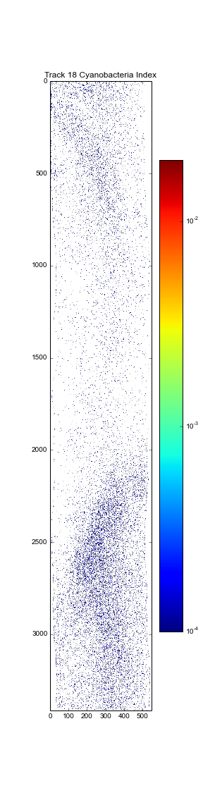
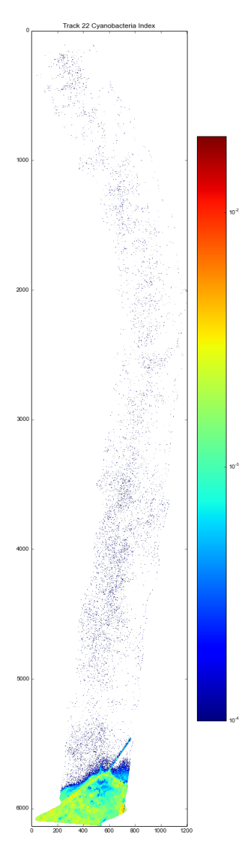
Tracks 18,22 – October 5, 2015
Track 18
Track 22
No Significant HABs

Slide 4
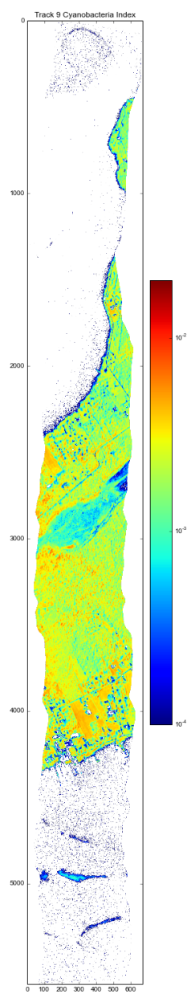
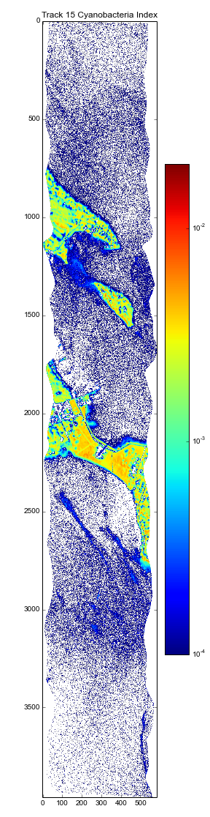
Tracks 9,15 – October 5, 2015
Track 9
Track 15
No Significant HABs detected
Streaks in bottom of both images possibly foam

Slide 5
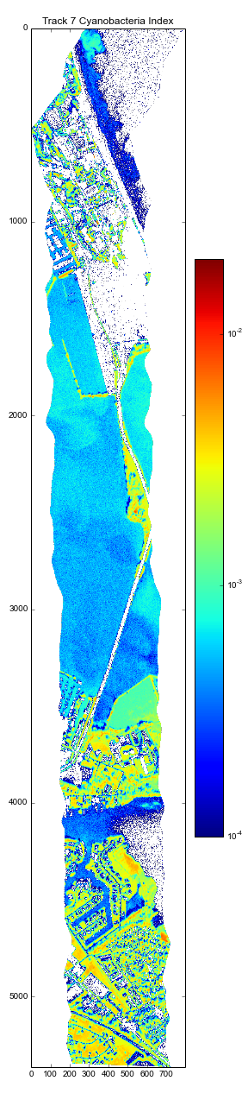
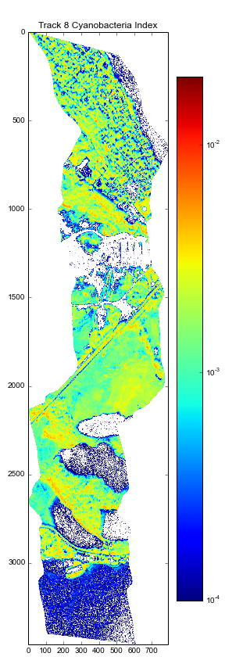
Tracks 7,8 – October 5, 2015
Track 7
Track 8
Track 7: Medium HABs detected
Track 8: No significant HABs detected

Slide 6
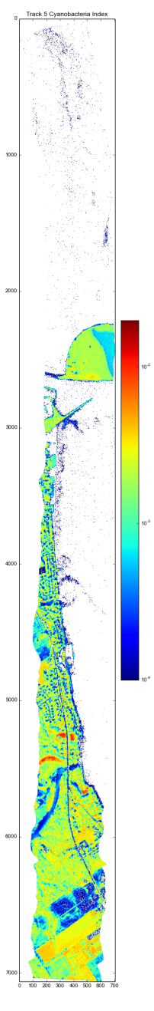
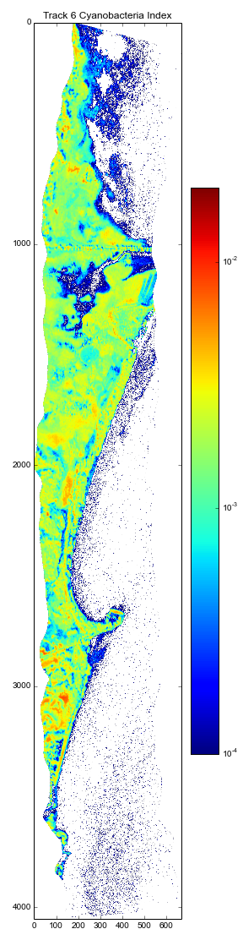
Tracks 5,6– October 5, 2015
Track 5
Track 6
No Significant HABs Detected

Slide 7
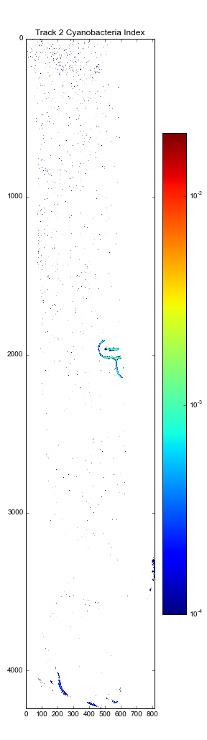
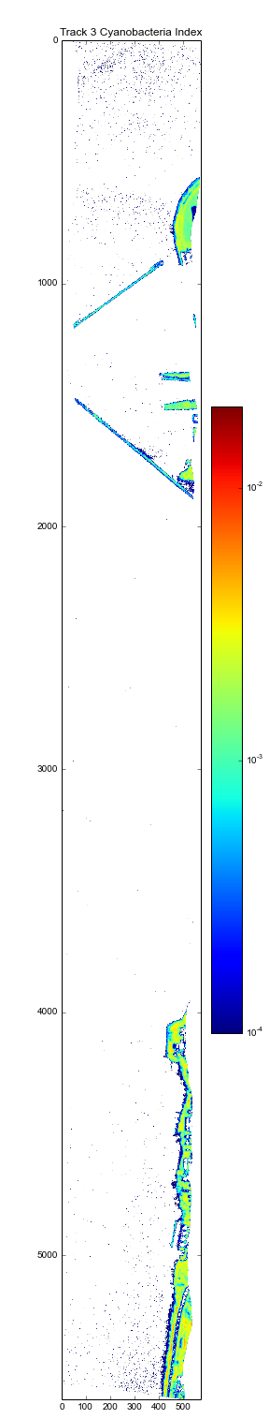
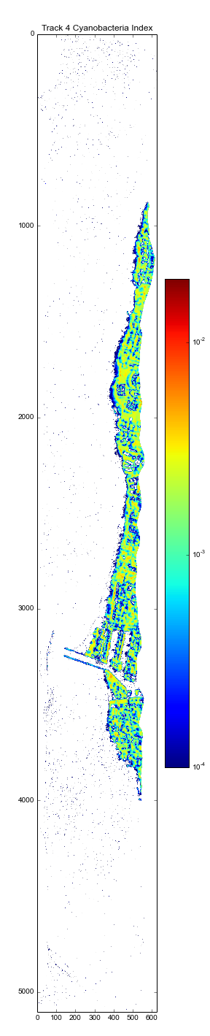
Tracks 2,3,4– October 5, 2015
Track 2
Track 3
Track 4
No Significant HABs Detected

Slide 8
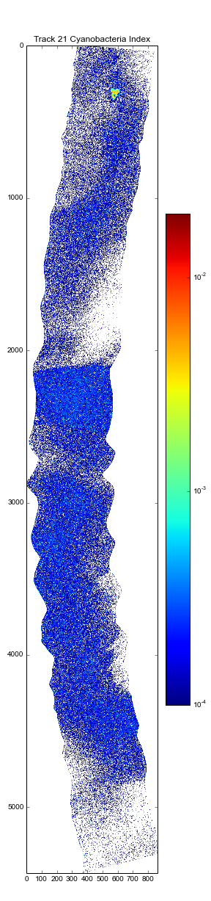
Track 21 – October 5, 2015
Track 21
Low to Medium HAB’s Detected

Slide 9
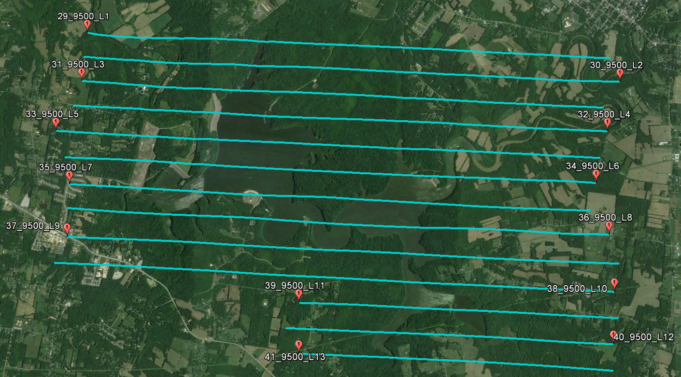
William H Harsha Lake – October 5, 2015

Slide 10
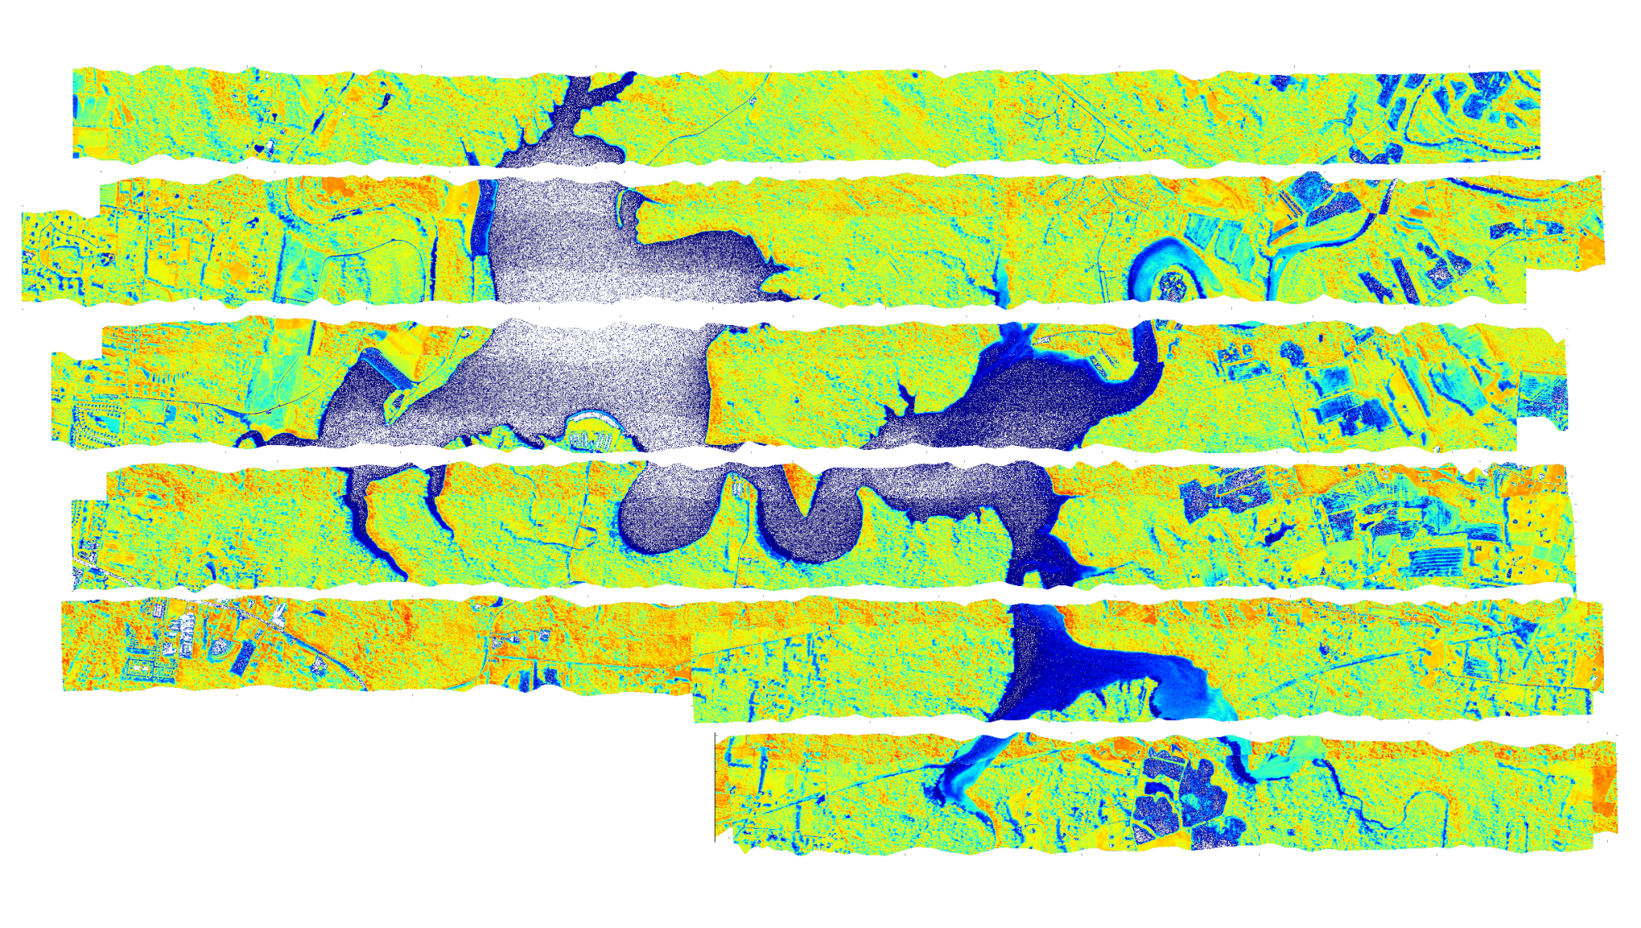
William H Harsha Lake – October 5, 2015
Possible Medium HABs in river mouths
Could be sediment or bottom influence

Slide 11
Quick Look Observations
Greatly diminished HABs presence in Western Basin
  Primarily Maumee Rivermouth and Sandusky Bay
No scum detected

