Slide 1
HABs Ohio River Quick Look – Flight on September 3, 2015
Bob Shuchman
Mike Sayers
Reid Sawtell
Glenn Sullivan

Slide 2
Quicklook HAB Products
Harmful Algal Blooms (HAB) identified using NASA GLEAMS airborne hyperspectral imagery
Cyanobacterial Index (CI) algorithm (Wynne et al. Stumpf et al.) applied to GLEAMS imagery
All CI images are shown on a log scale with hotter colors representing greater HAB presence
Note: Land pixels have not been removed, therefore high CI values associated with land are present in some images

Slide 3
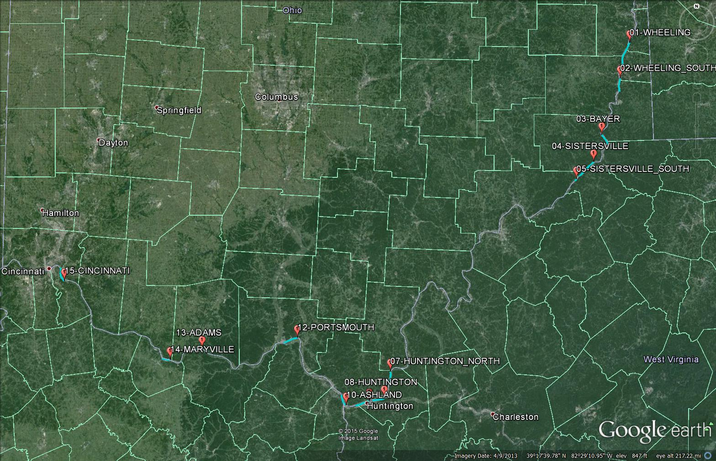
Aircraft Flight Lines - September 3, 2015

Slide 4
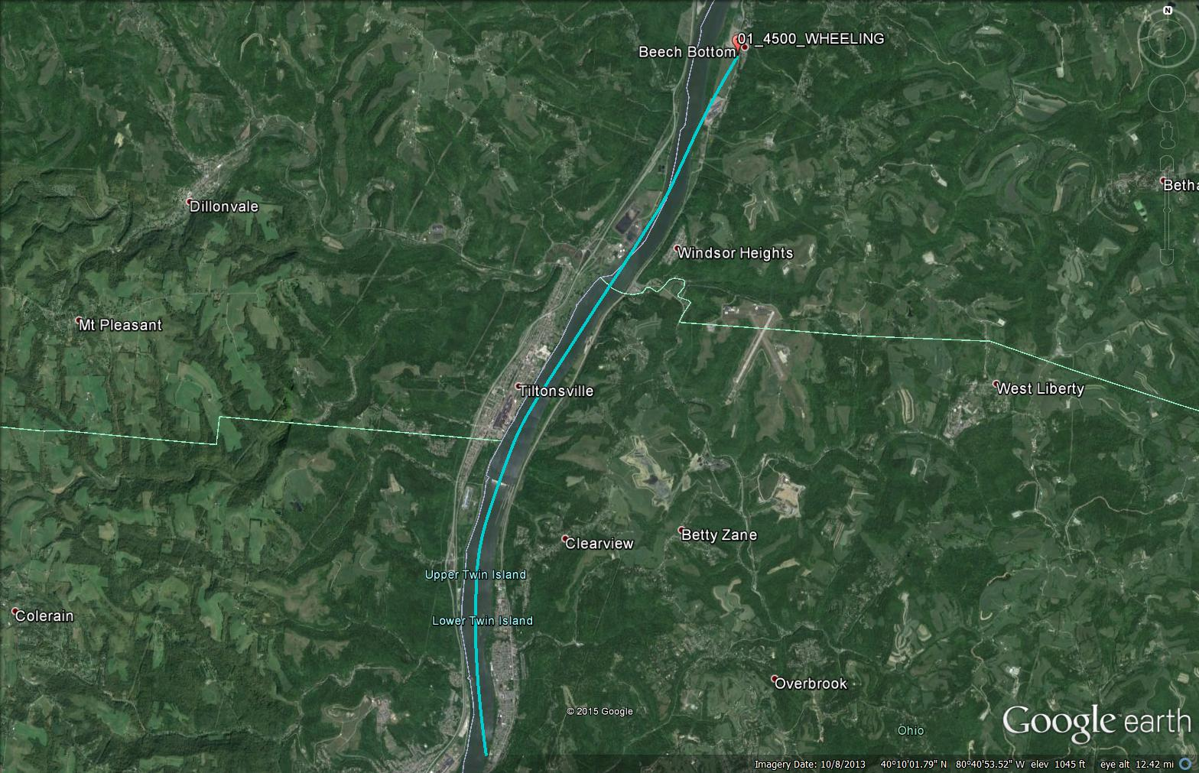
Tracks 1 – Wheeling – September 3, 2015

Slide 5
Tracks 1 – Wheeling – September 3, 2015
No significant HABs detected
Note: High CI values are land

Slide 6
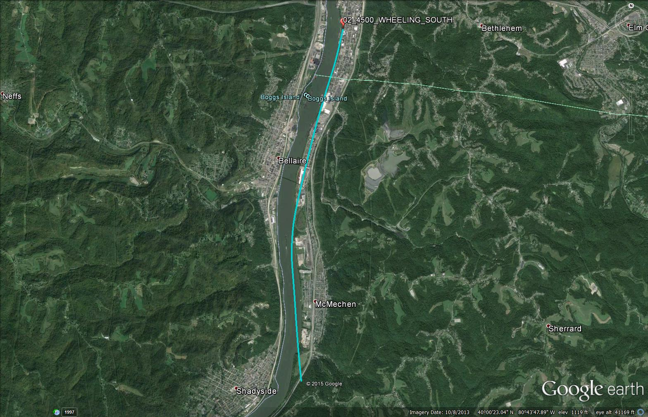
Tracks 2 – Wheeling South – September 3, 2015

Slide 7
Tracks 2 – Wheeling South – September 3, 2015
No significant HABs detected
Note: High CI values are land

Slide 8
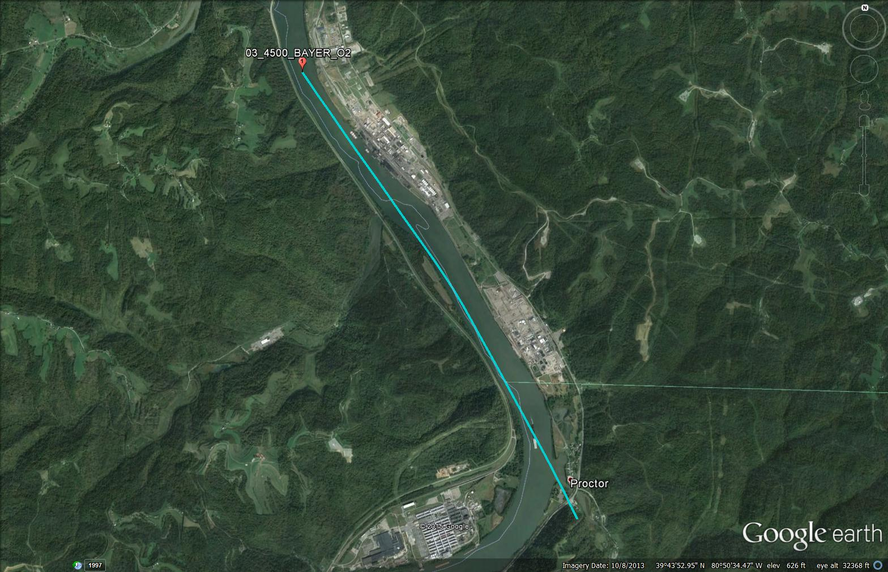
Track 3 – Bayer – September 3, 2015

Slide 9
Track 3 – Bayer – September 3, 2015
Track 3
Possible low level HABs detected
Note: High CI values are land

Slide 10
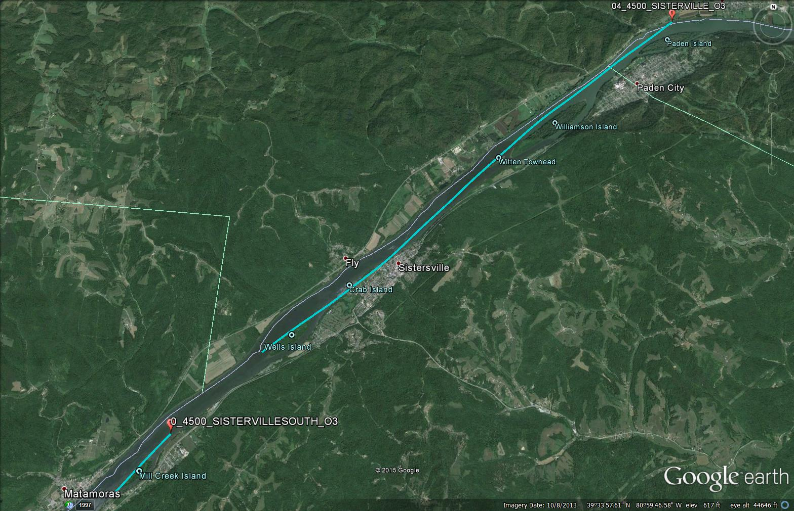
Tracks 4, 5 – Sistersville – September 3, 2015

Slide 11
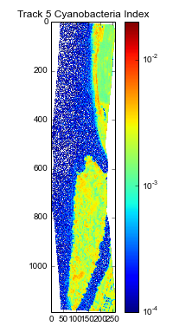
Tracks 4, 5 – Sistersville – September 3, 2015
Track 4
Track 5
No significant or very low HABs detected
Note: High CI values are land

Slide 12
Track 6 – September 3, 2015
No significant HABs detected
Note: High CI values are land

Slide 13
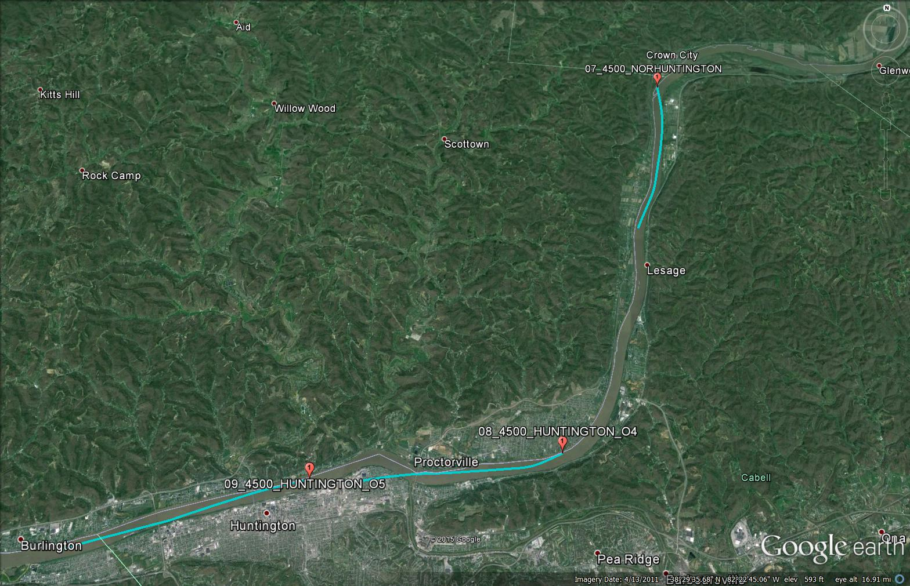
Tracks 7, 8, 9 – Huntington – September 3, 2015

Slide 14
Tracks 7, 8, 9 – Huntington – September 3, 2015
Track 7
Track 8
Track 9
Low to medium HABs detected
Note: Visible HABs streaks

Slide 15
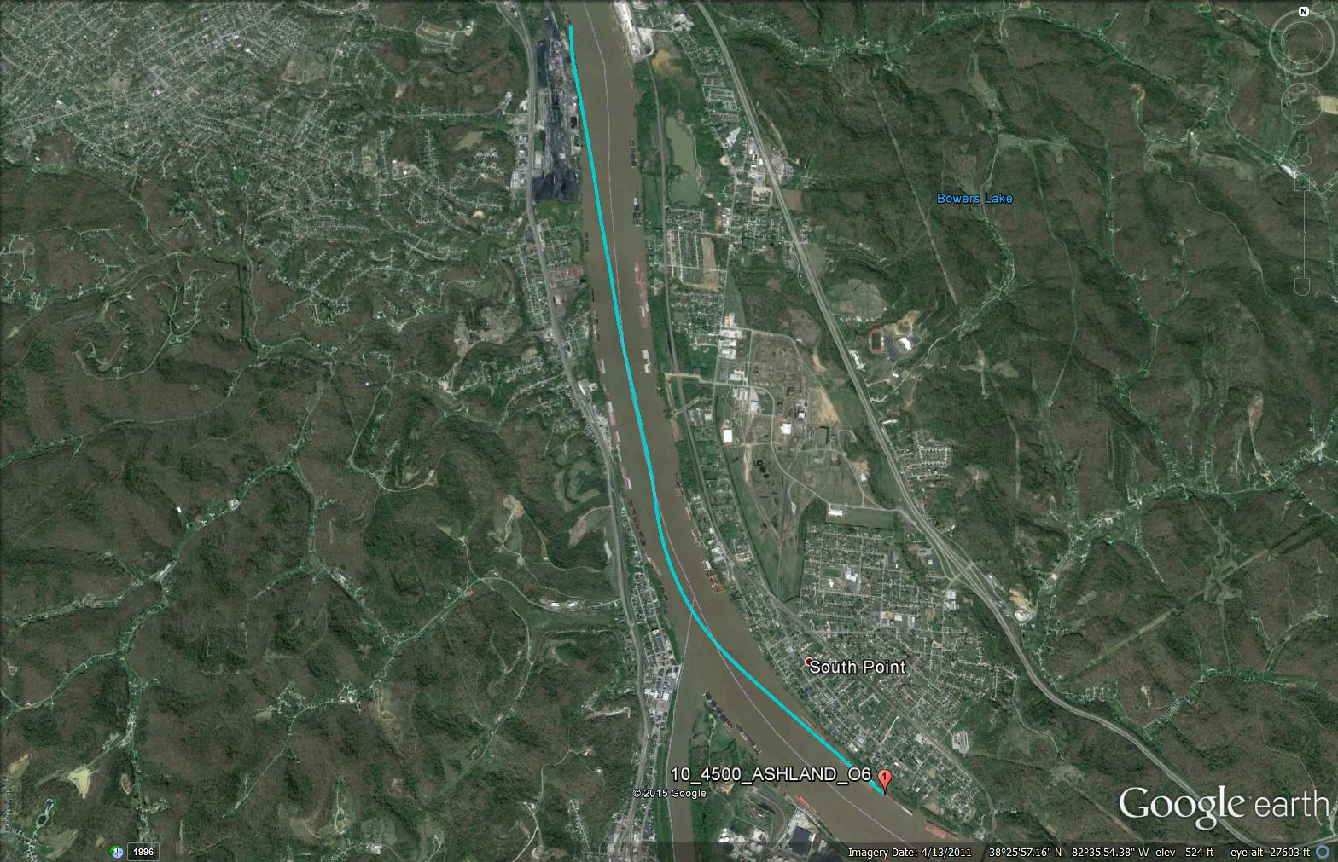
Track 10 – Ashland – September 3, 2015

Slide 16
Track 10 – Ashland – September 3, 2015
No significant HABs detected
Cloud shadows may interfere with results
Note: High CI values are land

Slide 17
Track 11 – September 3, 2015
Low to moderate HABs detected (at top of image)
Haze and clouds may interfere with results
Note: Bloom streak formation (top of image)

Slide 18
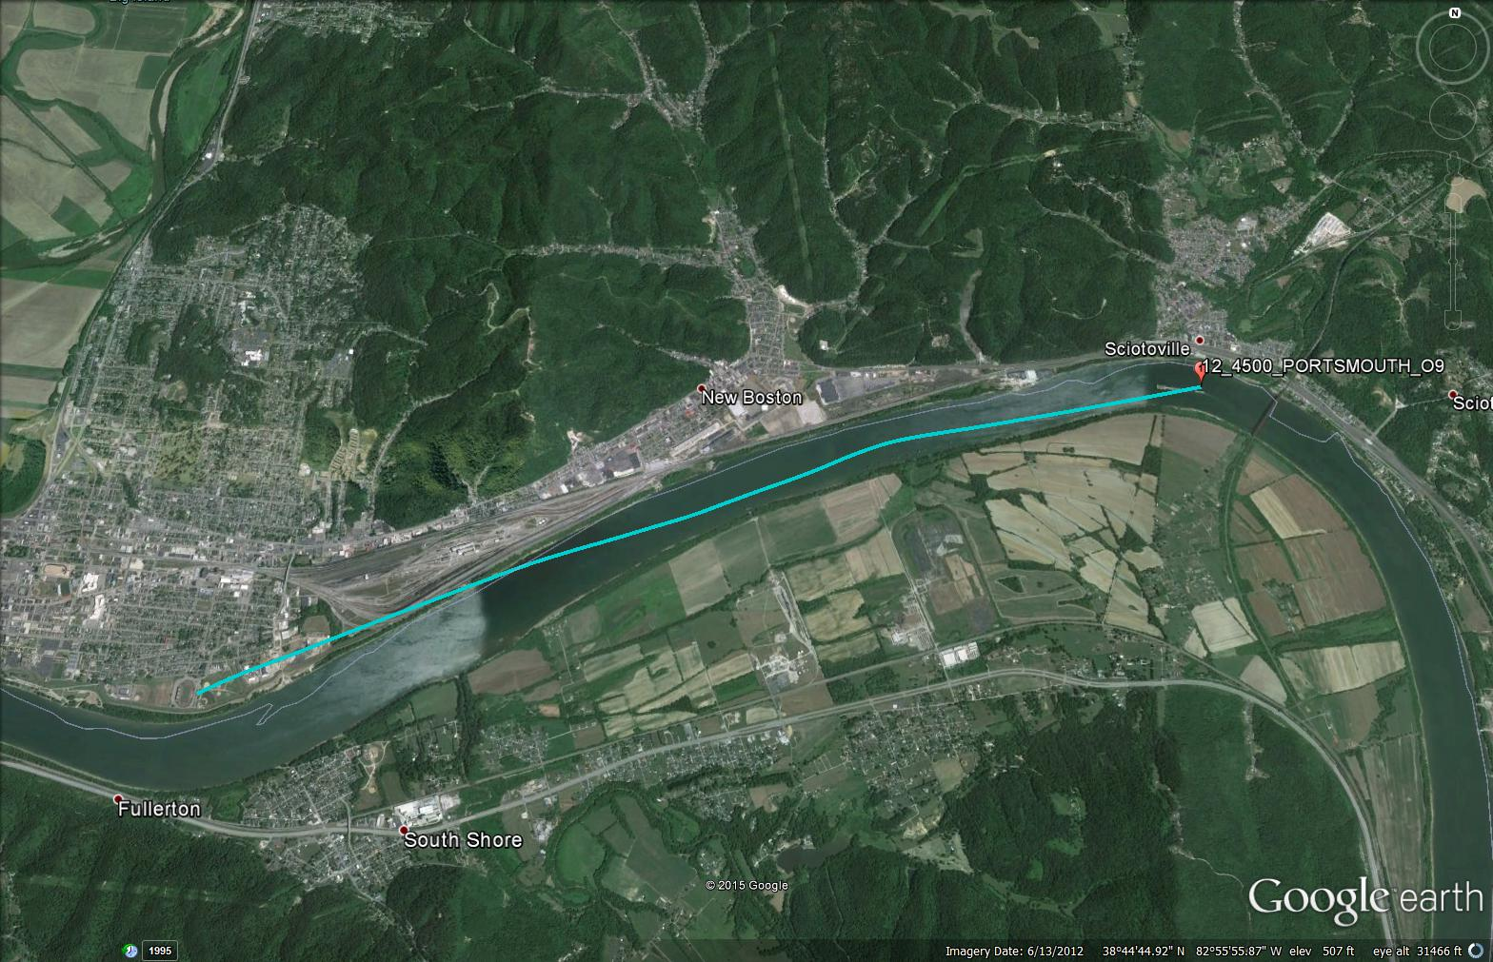
Track 12 – Portsmouth – September 3, 2015

Slide 19
Track 12 – Portsmouth – September 3, 2015
No significant HABs detected
Note: High CI values are land
Bright spots are clouds

Slide 20
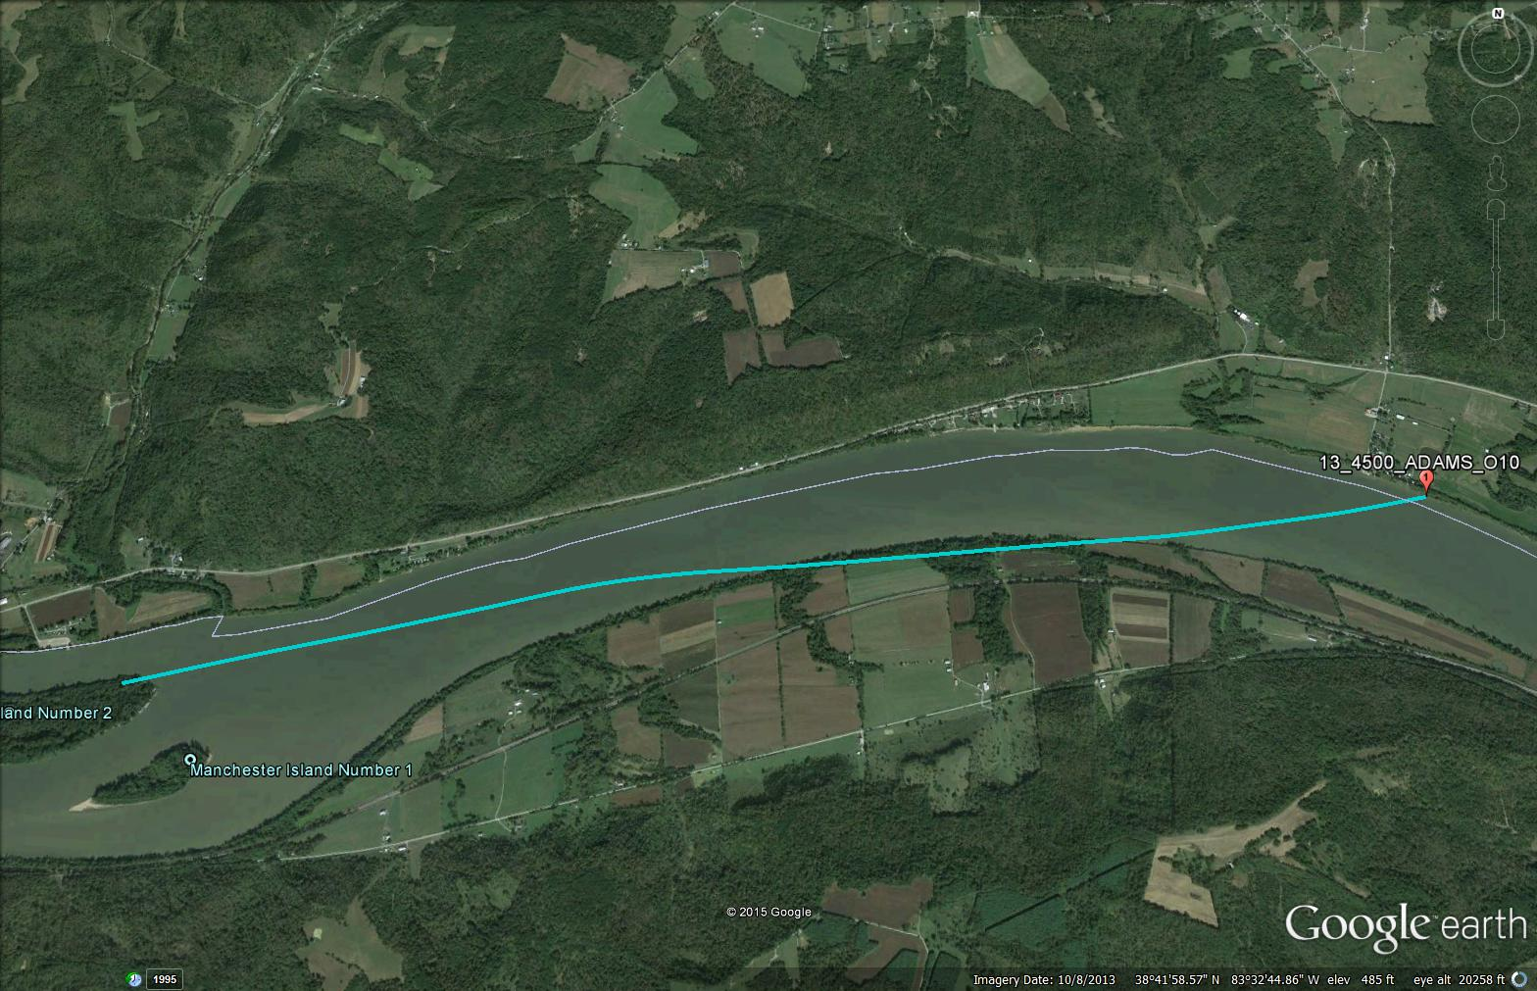
Track 13 – Adams – September 3, 2015

Slide 21
Track 13 – Adams – September 3, 2015
Possible low levels of HABs detected
Note: High CI values are land

Slide 22
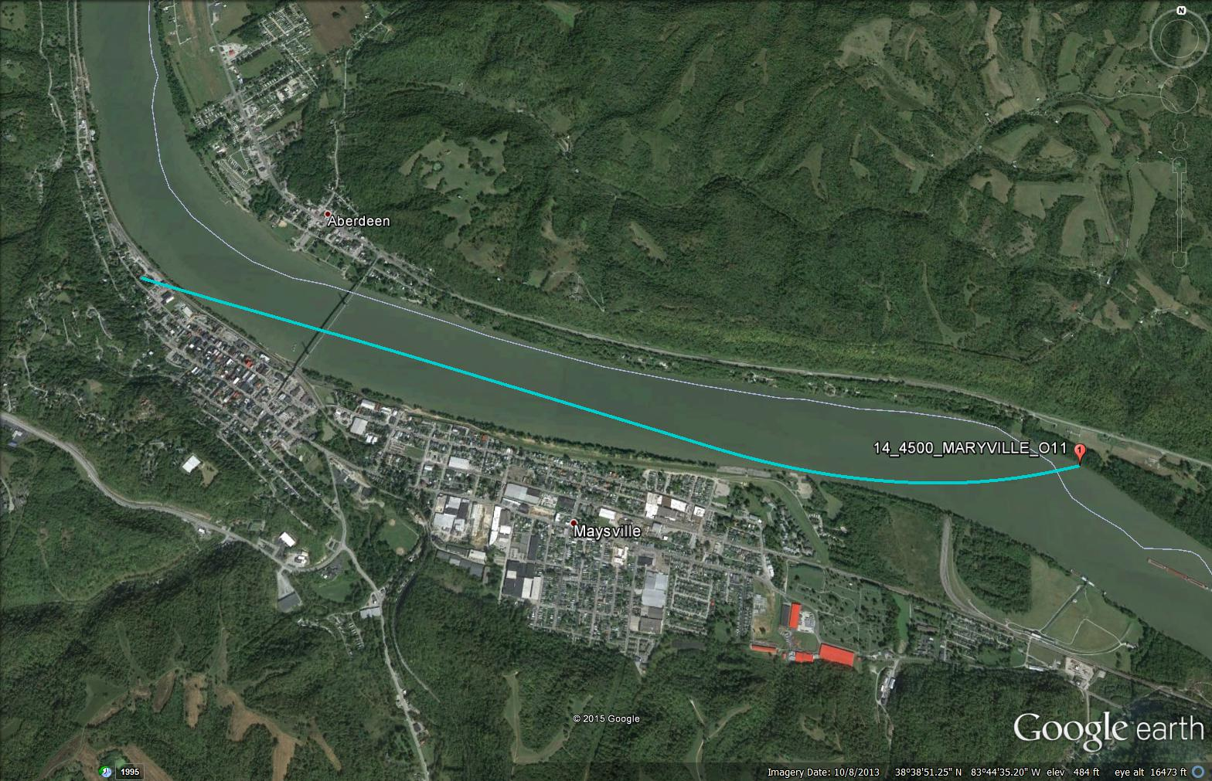
Track 14 – Maysville – September 3, 2015

Slide 23
Track 14 – Maysville – September 3, 2015
Medium HABs detected
Note: Visible bloom formation at bottom of the image along shoreline

Slide 24
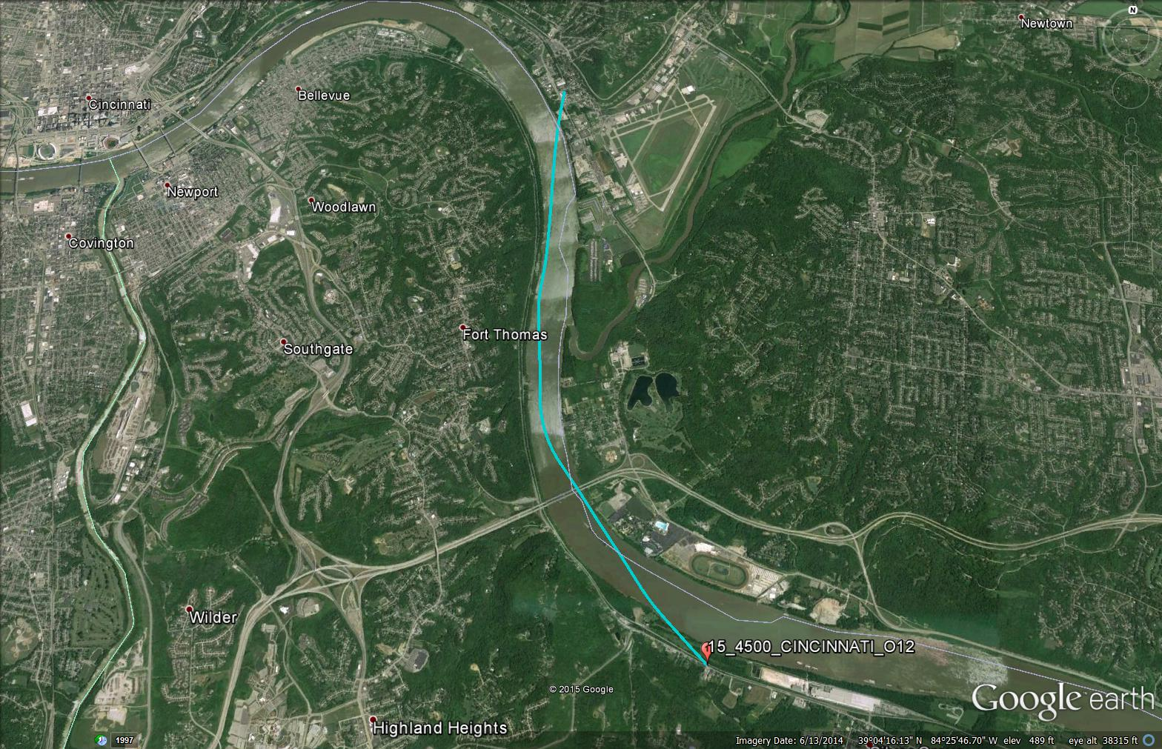
Track 15 – Cincinnati – September 3, 2015

Slide 25
Track 15 – Cincinnati – September 3, 2015
Possible low level HABs detected
Haze may interfere with results

Slide 26
Quick Look Observations
Huntington, Ironton, and Maysville areas have notable HAB formation indicated by NASA GLEAMS derived CI
Possible low level HABs indicated in other areas along Ohio River
Cloud and cloud shadows interfere with CI results
Applicability of CI to inland waters has not been fully tested

